Slide 1
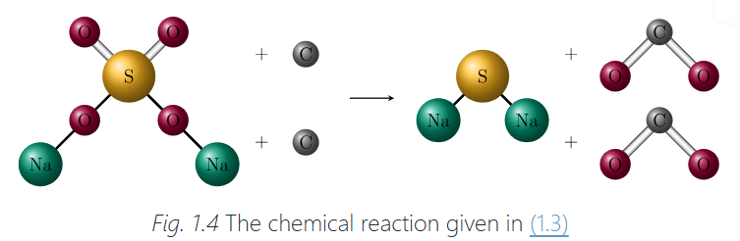

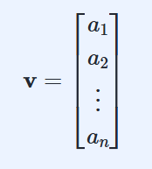
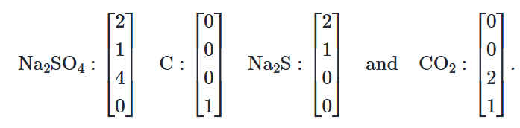
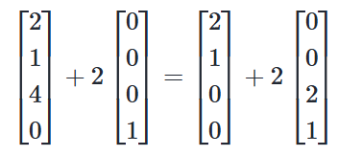

Why it appears?
Information about an object not in one number but in one thing.
Vector
example
entries
vector
Column vector
Entries/components
N: the size of the vector

Slide 2
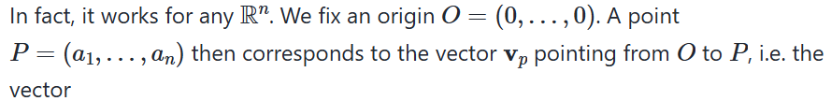
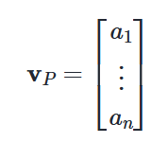
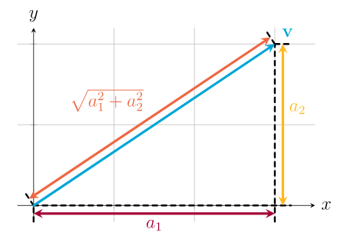

Establish a link between points and vectors by introducing a sort of common anchor point for all vectors.

Slide 3
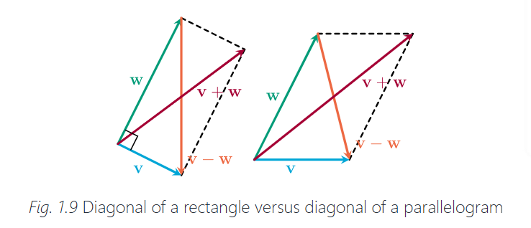
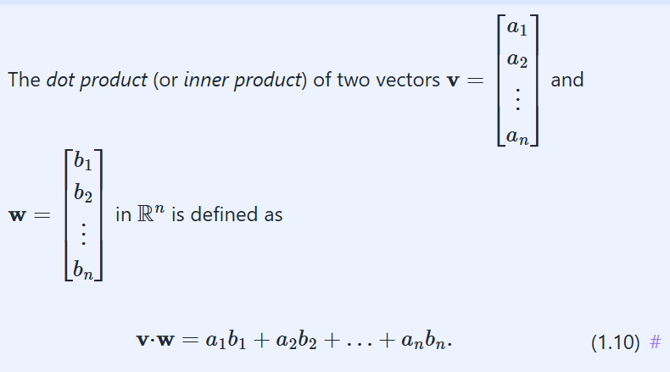
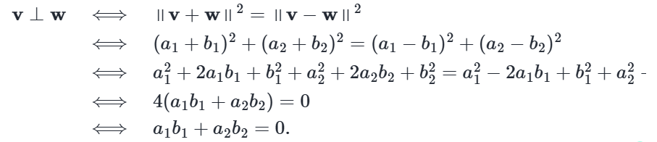
Dot product

Slide 4



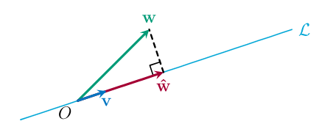







Orthogonal
Cauchy-Schwarz Inequality)
Orthogonal projection
proof
norm
angles
distance
Unit vector
Proof

Slide 5
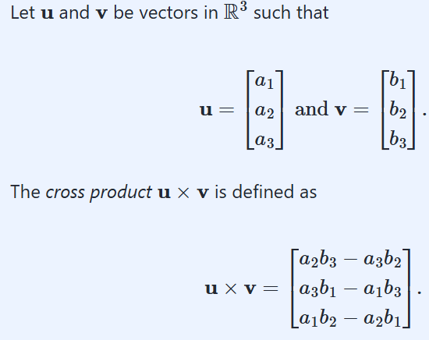


Cross product
allows us to construct a vector that is orthogonal to two given vectors.
Determinant

Slide 6
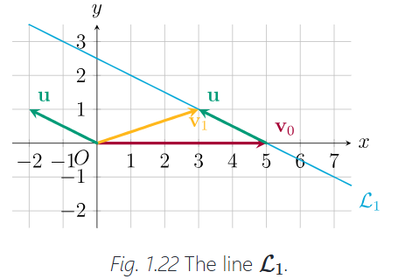

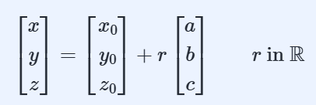

Lines
Cartesian equation
Directional vector
Parametric vector equation
Normal vector
Normal equation

Slide 7
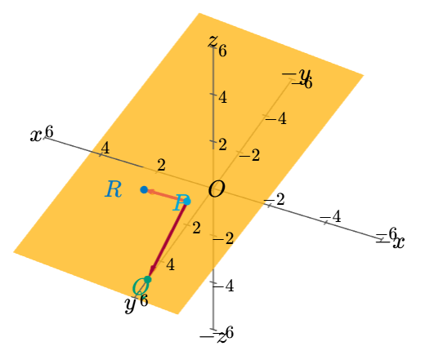


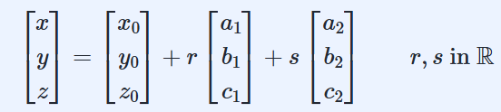
Planes
Cartesian equation
Normal equation
Parametric vector equation

Slide 8
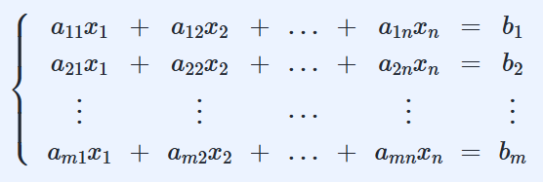
Linear equation
coefficient
unknowns
Constant term
Linear system
Solution set
consistent
inconsistent
Scaling
Backward substitution

Slide 9
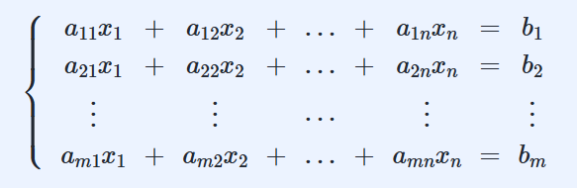
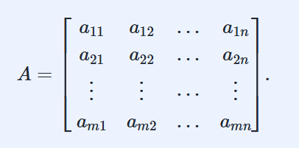
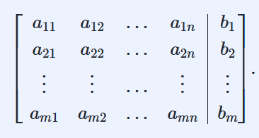
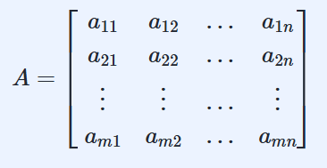
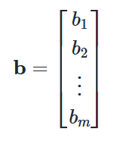
Augmented matrices
rows
columns
coefficient matrix

Slide 10
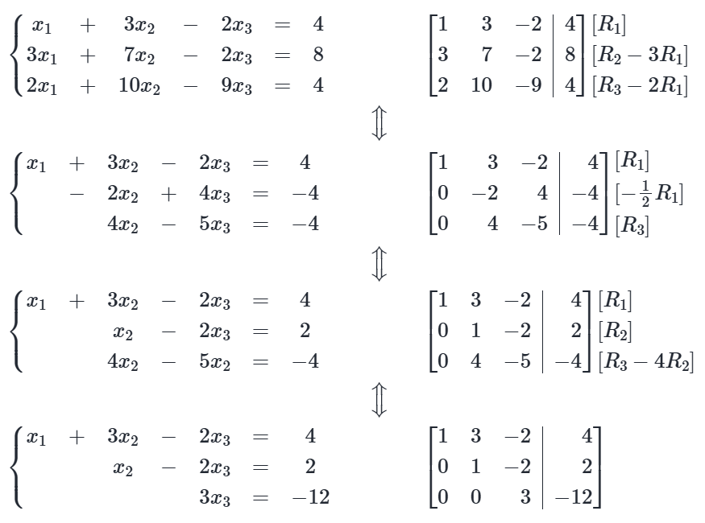

Slide 11
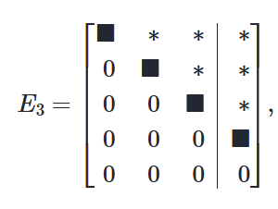
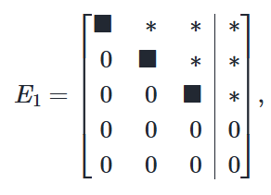
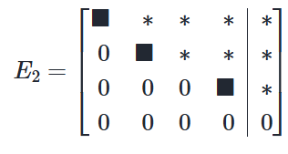
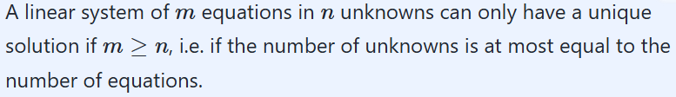
Echelon form
pivot
Row reduction

Slide 12

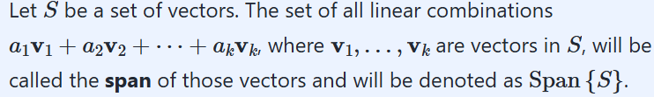
Linear combination
Span
Standard basis

Slide 13
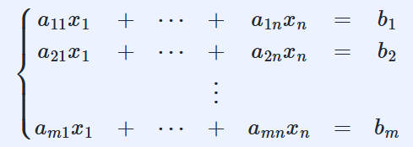
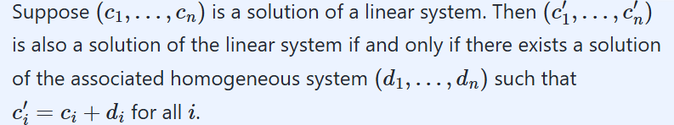
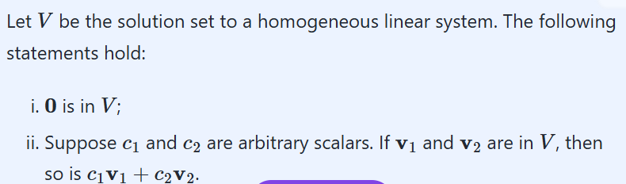
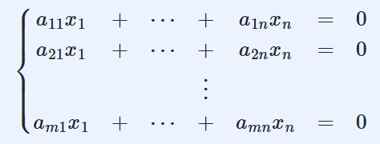
Solution set
Associated homogeneous system

Slide 14
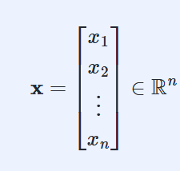


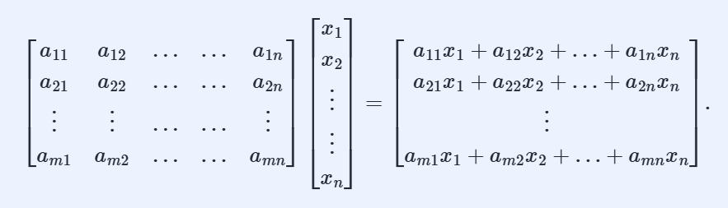
The matrix-vector product Ax

Slide 15

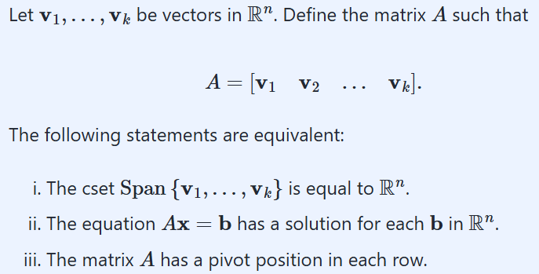

Slide 16
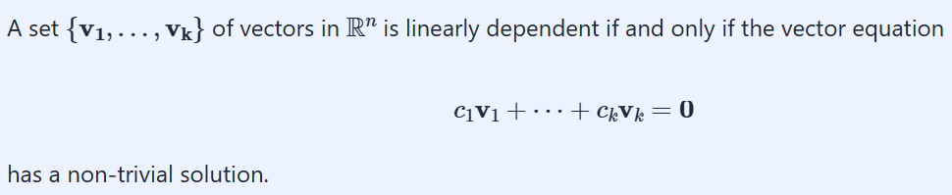

？
the columns of a matrix are linearly dependent if and only if there is some column which is linearly dependent on the preceding ones.

Slide 17

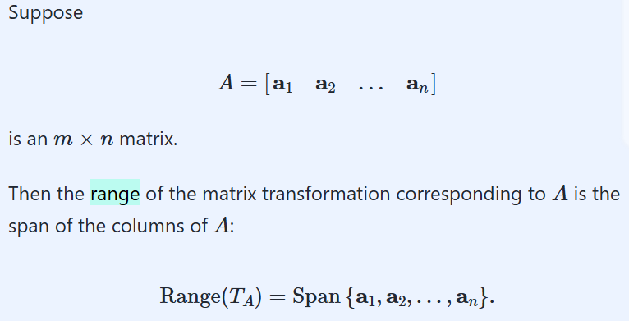


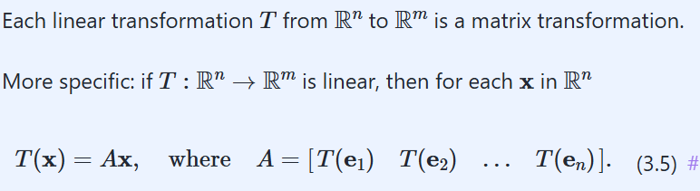
matrix transformation
linear transformation
standard matrix

Slide 18
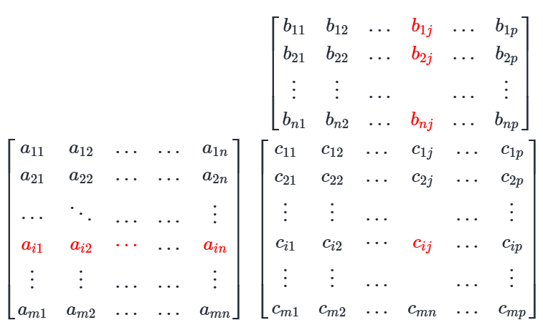

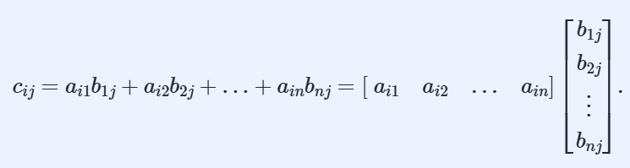
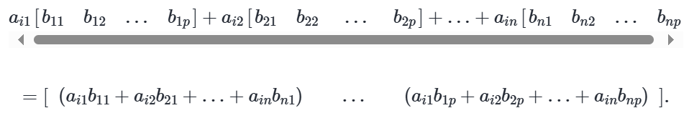
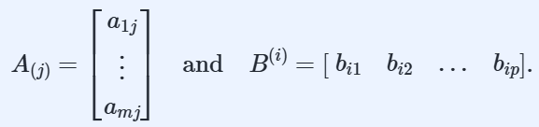
Matrix operations
Square matrix
Diagonal elements
Sum, Scalar multiplication, Transpose
Identity matrix
Product
Column-Row expansion
*Prove A(BC)=(AB)C

Slide 19

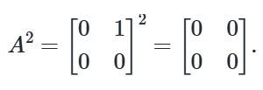

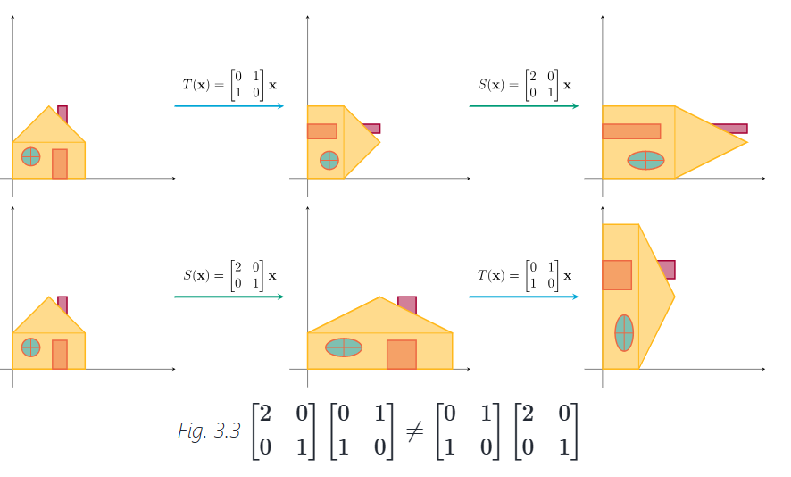


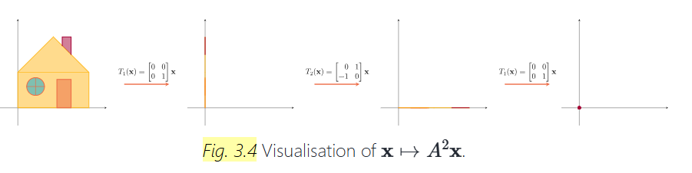
Properties
non-commutativity
non-zero

Slide 20
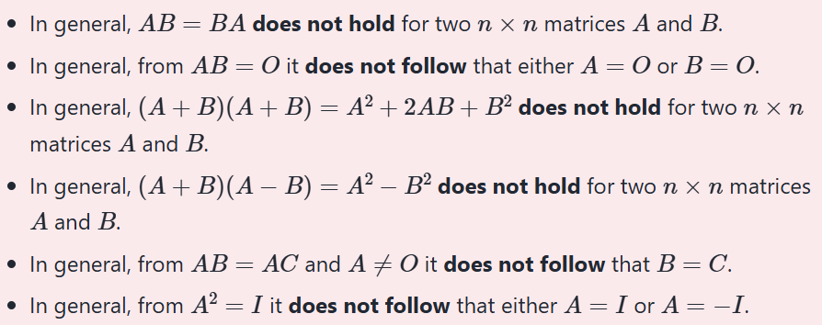


Slide 21

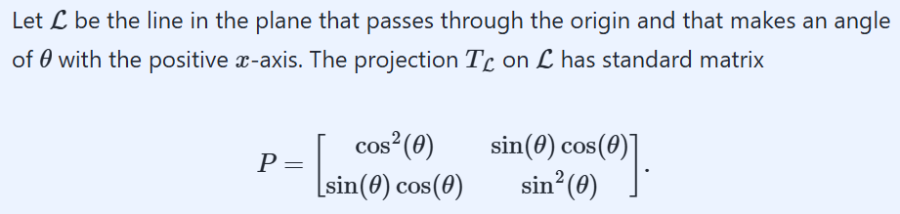

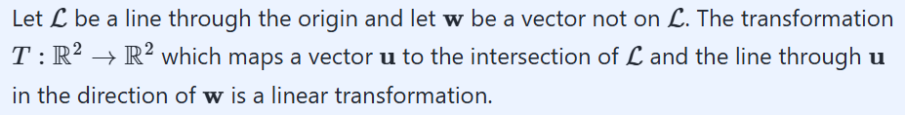
Some linear transformation
Projection
y
L
w
x
v

Slide 22
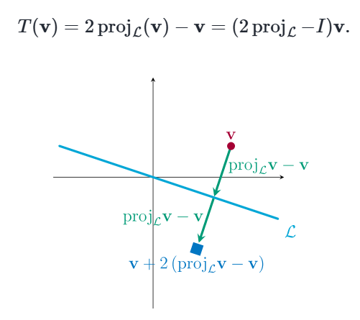
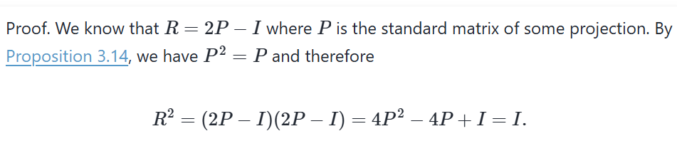


Reflection
preserve lengths of vectors and angles between vectors

Slide 23




Rotation
prove

Slide 24




Shear transformation
example

Slide 25










The inverse of matrix
If A is a square matrix, then AX =I has a unique solution if and only if A has linearly independent columns.
How to compute the inverse
*idea is very interesting

Slide 26

For a square matrix A : if AB = I , the BA = I

Slide 27


Injectivity
Verse not

Slide 28



Surjectivity
Verse not

Slide 29


Bijectivity

Slide 30



Matrix factorisation
Trapezoidal and Triangular matrices
upper trapezoidal matrix
lower trapezoidal matrix
Proof 逆推

Slide 31

LU decomposition
See example 3.45 和求A⁻¹对比
*Proof

Slide 32

PLU decomposition
**Application

Slide 33





Subspace of R^{n}
trivial subspace
*image

Slide 34



Basis of a subspace
standard basis
Dimension of a subspace

Slide 35






Row space and rank

Slide 36



Change of basis
Example 4.24 & 4.25 &4.26

Slide 37



Determinants as areas or volumes

Slide 38





Slide 39


Determinants via cofactors expansion

Slide 40



Determinants via row reduction

Slide 41




Orientation and Volume

Slide 42


Cramer’s rule

Slide 43




The inverse of a matrix in terms of determinants
cofactor matrix
adjugate matrix

Slide 44


Determinant and cross product
Prove

Slide 45




Eigenvalue and eigenvector
Eigenspace
Proof.

Slide 46




The Characteristic Polynomial
algebraic multiplicity
geometric multiplicity
trace

Slide 47



Similar matrices
A and B are in fact matrices of the same linear transformation, only with respect to different bases.
Diagonalizability
Prove(has error)

Slide 48



Complex conjugate

Slide 49



Hidden rotation
?

Slide 50

Orthogonal complements
Orthogonal decomposition
orthogonal projection

Slide 51





Orthogonal basis
Orthogonal projection
Orthogonal matrix

Slide 52



The Gram-Schmidt process
The QR decomposition

Slide 53



Least squares solutions
least squares error
normal equations
prove
Linear Models

Slide 54



symmetric matrix
矩阵分块
Prove?

Slide 55

The Spectral Decomposition of a Symmetric Matrix
Example 8.9

Slide 56




Quadratic Forms
the matrix of the quadratic form
A is a symmetric matrix

Slide 57



Diagonalization of quadratic forms
Sylvester’s Law of Inertia

Slide 58


Positive definite matrices
Conic Sections

Slide 59


Singular Value Decomposition
Collected by Witty

